Slide 1

SVPM’S College Of EngineeringMalegaon (Bk) Baramati Department Of Electrical Engineering
Presented By
Title of Project
“SMART AND AUTOMATIC WHEELCHAIR FOR DISABLED PERSON USING HAND GESTURE”
Date
13/6/2025
Project Guide
Mr. J. H. Pawar
Mr. Margale Ketan Pandurang | [B400190095]
Mr. Matkar Dhananjay Sunil | [B400190097]
Mr. Sarak Ajit Hanumant | [B400190107]

Slide 2
CONTENTS
Problem Statement
Objectives
Introduction
Literature Survey
About the Project
Components
Contruction
Proposed Method & Operation

Slide 3
Result
Future Scope
Reference

Slide 4
PROBLEM STATEMENT
To select correct dimension and parameter wheelchair fabrication.
Motor selection: Choose motors that can provide sufficient torque and speed for the wheelchair’s weight and desired performance.
To control motor speed: Implement a control system, like PWM (Pulse Width Modulation), to regulate motor speed accurately.
Wheelchair rotate: Design the wheelchair with the ability to rotate in place, which may involve differential steering or additional hardware.

Slide 5
OBJECTIVES
Enhance User Independence
Improve Safety and Security
Ensure Cost-Effectiveness
Adapt to Diverse User Needs

Slide 6
Introduction
Wheel chair is the best assistive device used by the elder and disabled people.
The driving and controlling of traditional wheel chair are much harder task.
Our aim is to build a low-cost and powerful wheel chair that helps handicapped people to travel without depending on others.
Introducing a type of a cost-efficient electronic gesture-based wheel chair.
Easy to operate, because this wheel chair can be operated even by a user without a palm.

Slide 7
LITERATURE SURVEY
Sr.No | Paper Name | Author Name | Publish date | Abstract
1. | DESIGN AND DEVELOPMENT OF SMART WHEELCHAIR SYSTEM USING HAND GESTURE CONTROL | Priya Darshini B, Satheesh Kumar S. | 2022 | In this paper, the proposed system aims at designing and developing a hand gesture controlled semi-autonomous electric wheelchair that is adaptable both indoors and outdoors. The system is designed in such a way the user can operate the wheelchair using hand gestures and android application.
2. | DESIGN OF A LOW-COST HAND GESTURE CONTROLLED | Mufrath Mahmood Md. , Fahim Rizwan ,Md. Habib | 2020 | In this Paper, Design and implementation of a low-cost hand gesture controlled automated wheelchair-using Arduino based microcontroller and Node MCU is presented in this paper. The main focus of this study is to control the wheelchair with the movement of the hand-wrist movement.
3. | HEAD MOVEMENT CONTROL OF POWERED WHEELCHAIR | Razvan , Solea Alexandru Margarit, Daniela Cernega , Adrian Serbencu | 2019 | This paper presents an efficient method to imple ment head gesture recognition to be the base of a framework for the physically disabled people. Currently, the most common way to control an powered wheelchair is to use a joystick.
4. | REAL-TIME HAND-GESTURE RECOGNITION FOR THE CONTROL OF WHEELCHAIR | Md Rafiul Huda, Md. Liakot Ali, Muhammad Sheikh Sadi | 2022 | This paper develops a prototype of an advanced algorithm for gesture recognition and decision making for a control system for smart wheelchair (built with advanced and automated features) users, in line with contemporary technologies.

Slide 8
ABOUT THE PROJECT
Hardware Components
Mechanical Assembly
Arduino UNO
MPU-6050
Relay Module
DC Gear Motor
Battery
Software Component
Arduino IDE

Slide 9
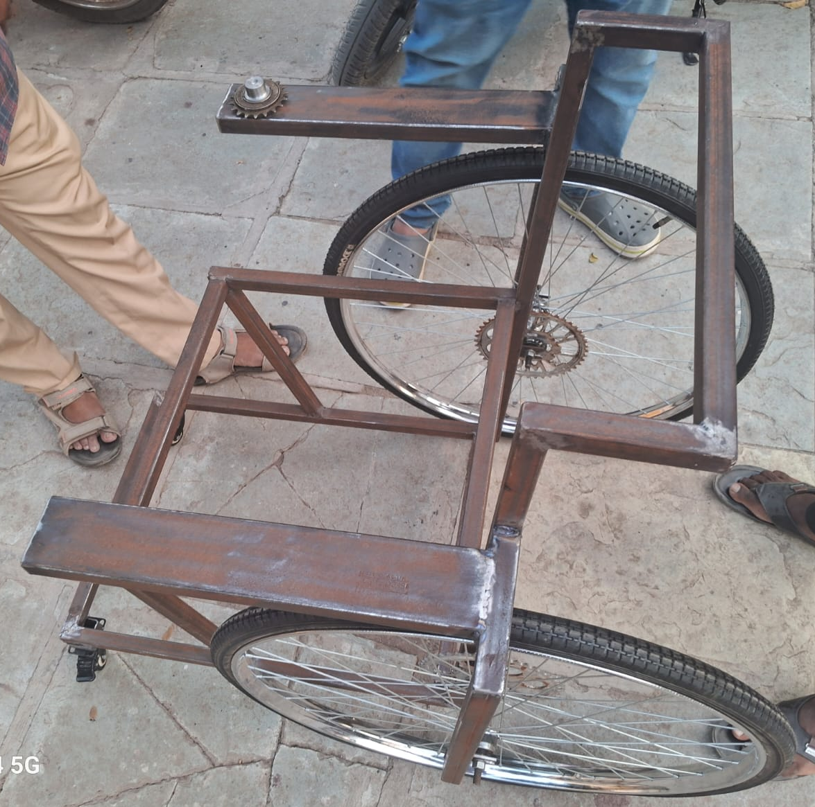
Hardware Component
1. Mechanical Assembly

Slide 10
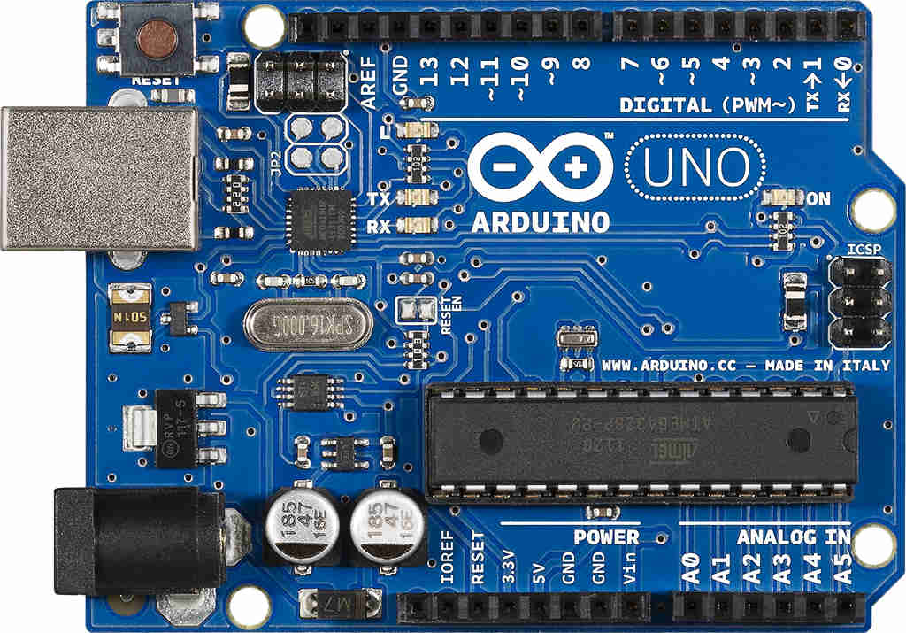
2. Arduino UNO
Based on the ATmega328P
14 digital input/output
6 can used as PWM output
6 analog inputs
16 MHz ceramic resonator
ICSP header and A reset button
Works on 12v Battery supply which should be constant

Slide 11
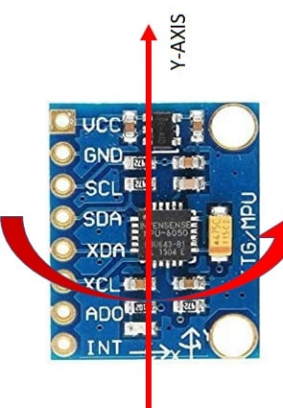
MPU-6050
Chip built-in 16bit AD converter, 16-bit data output.
I2C Digital-output of 6 or 9-axis MotionFusion data in rotation matrix, quaternion, Euler Angle, or raw data format.
Selectable Solder Jumpers on CLK, FSYNC, and AD0.
Digital Motion Processing(DMP) engine offloads complex Motion

Slide 12
Embedded algorithms for run-time bias and compass calibration. No user intervention is required.
Digital-output temperature sensor.
Fusion, sensor timing synchronization, and gesture detection.

Slide 13
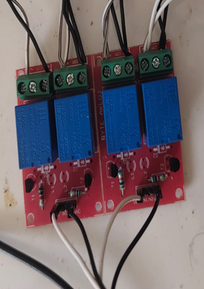
4. Relay Module
Contact Configuration:-
SPDT relays which has one common terminal , one normally
open terminal and one normally closed terminal
Coil voltage:-
The voltage required to energize the relay coil, typically
5–48 V DC or AC.

Slide 14
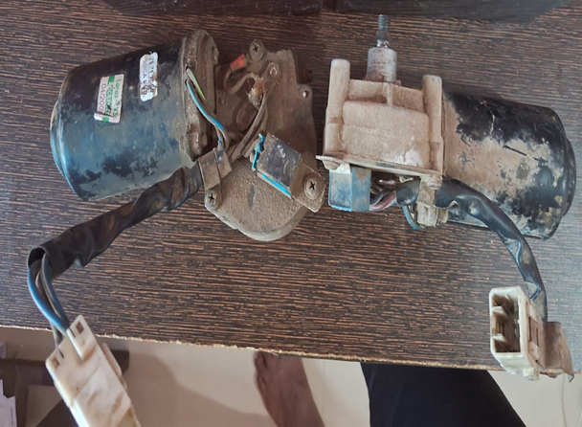
DC Gear Motor
Gear Motor for moving wheelchair
1.Voltage:- 12 V
2.Current :- 4-6 A
3.Speed :- 45 rpm
4.Power:- 80 W

Slide 15
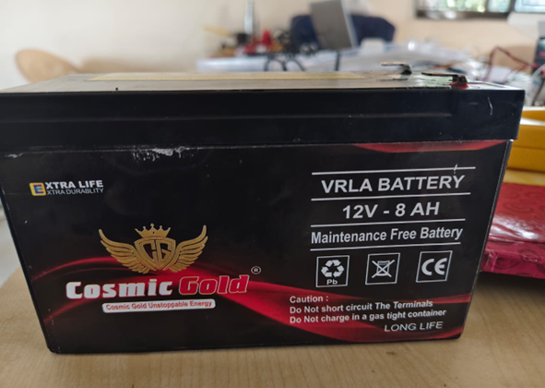
Battery
Voltage:- 12v
Current:- 8Ah
Warranty:- 1 year
Brand:- Cosmic Gold
Battery Type:-VRLA( Valve Regulated Lead- Acid Battery )

Slide 16
Software Component
Arduino IDE
Key Features
Code Autocomplete: Speeds up coding by suggesting possible completions based on your input.
Debugging Tools: Integrated debugging support, making it easier to test and troubleshoot sketches.
Library Management: Easily install and manage libraries for various hardware and sensors.
Board and Libraries Manager: Simplifies the process of adding new boards and libraries to your environment.
Cloud Compatibility: Option to use online IDE for programming from anywhere with internet access

Slide 17
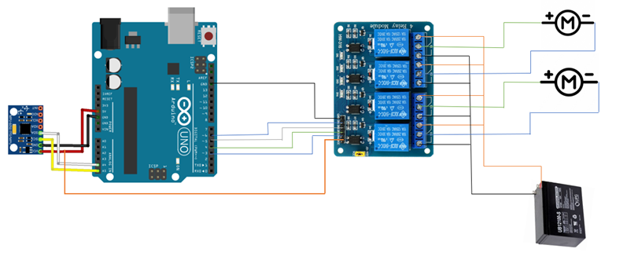
CONSTRUCTION

Slide 18
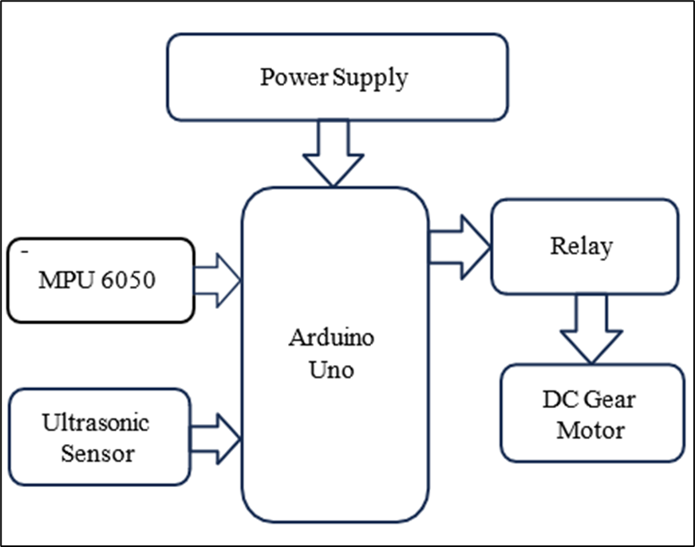
PROPOSED SYSTEM AND OPERATION
Block Diagram
Movements Of Motors According To Hand Gesture
Direction Of Hand Gesture | Movement Of Left Motor | Movement Of Right Motor
Downward | Forward | Forward
Upward | Backward | Backward
Right | Forward | Backward
Left | Backward | Forward

Slide 19
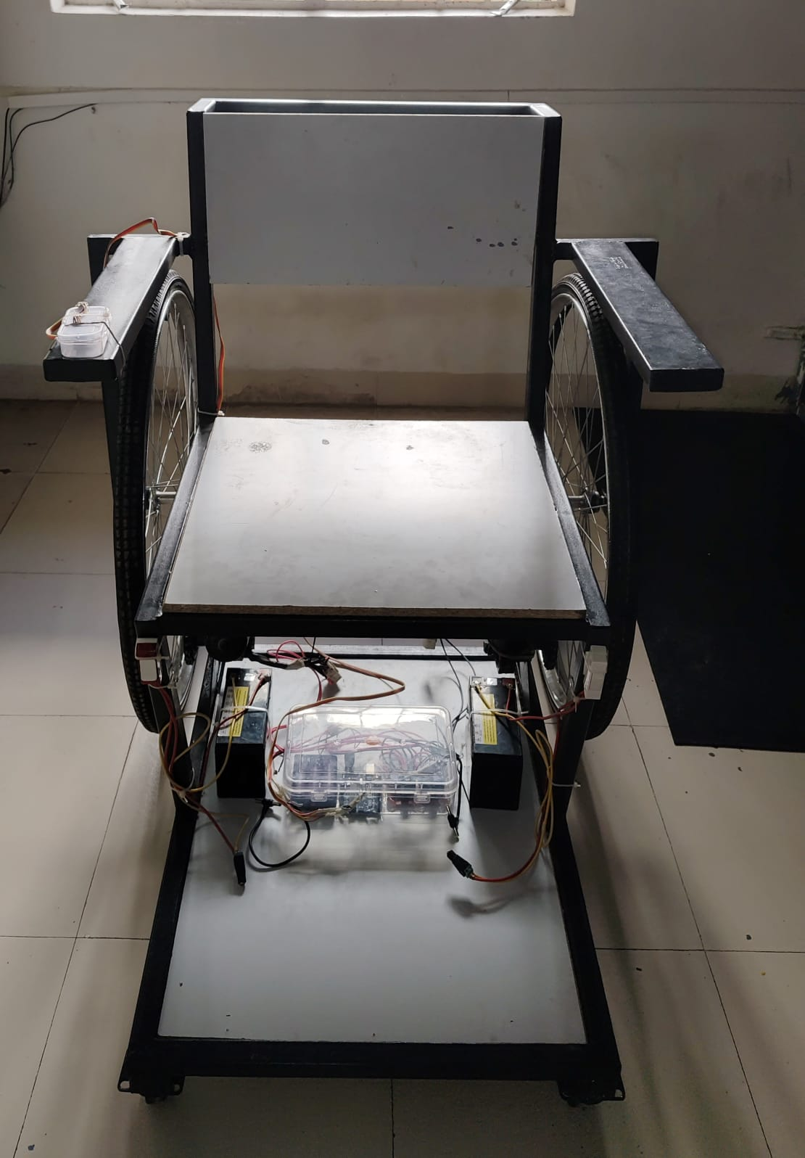
RESULT
Battery takes 2 hr. to 2.30 hr. full charge
Ones the fully charge battery discharge time is 1.30 HR’s
Battery current are 8amp and 12 volt supply.
The wiring resistance are 0.2 gauge.
The all electrical equipment are 12 volt supply

Slide 20
FUTURE SCOPE
Automated wheel chair can be operated by a wireless remote which can reduce the wiring arrangement.
Instead of using acceleration motion we can use the eye retina using an optical sensor to move wheel chair accordingly.
We can use voice command ICs to interface our voice signal with the microcontroller.
This system can be extended by including GSM which sends an SMS during an emergency.
Research is going on the development of handicapped wheel chair using the nervous system of humans.

Slide 21
REFERENCE
Mufrath Mahmood, Md Fahim Rizwan, Masuma Sultana, Md Habib and Mohammad Imam, "Design of a low-cost Hand Gesture Controlled Automated Wheelchair", 2020.
Hemlata Sharma and Nidhi Mathur, "Smart Wheelchair Remotely Controlled by Hand Gestures", 2021.
Prannah Dey, Md Hasan, Srijon Mostofa and Ariful Rana, "Smart wheelchair integrating head gesture navigation", pp. 329-334, 2019.
Swarnika Shruti and Savita Kumari Verma, "Arduino Based Hand Gesture Controlled Robot", International Research Journal of Engineering and Technology (IRJET), 2022.

Slide 22
Sarnali Basak, Fariha Nandiny, S. M. Mazharul Hoque Chowdhury and Al Amin Biswas, "Gesture based Smart Wheelchair for Assisting Physically Challenged People", 2021.

Slide 23
Thank You

